Slide 1
Building a sun seeking solar powered robot to eliminate the need for charging
By:Christopher Hunt

Slide 2
Background Information

Slide 3
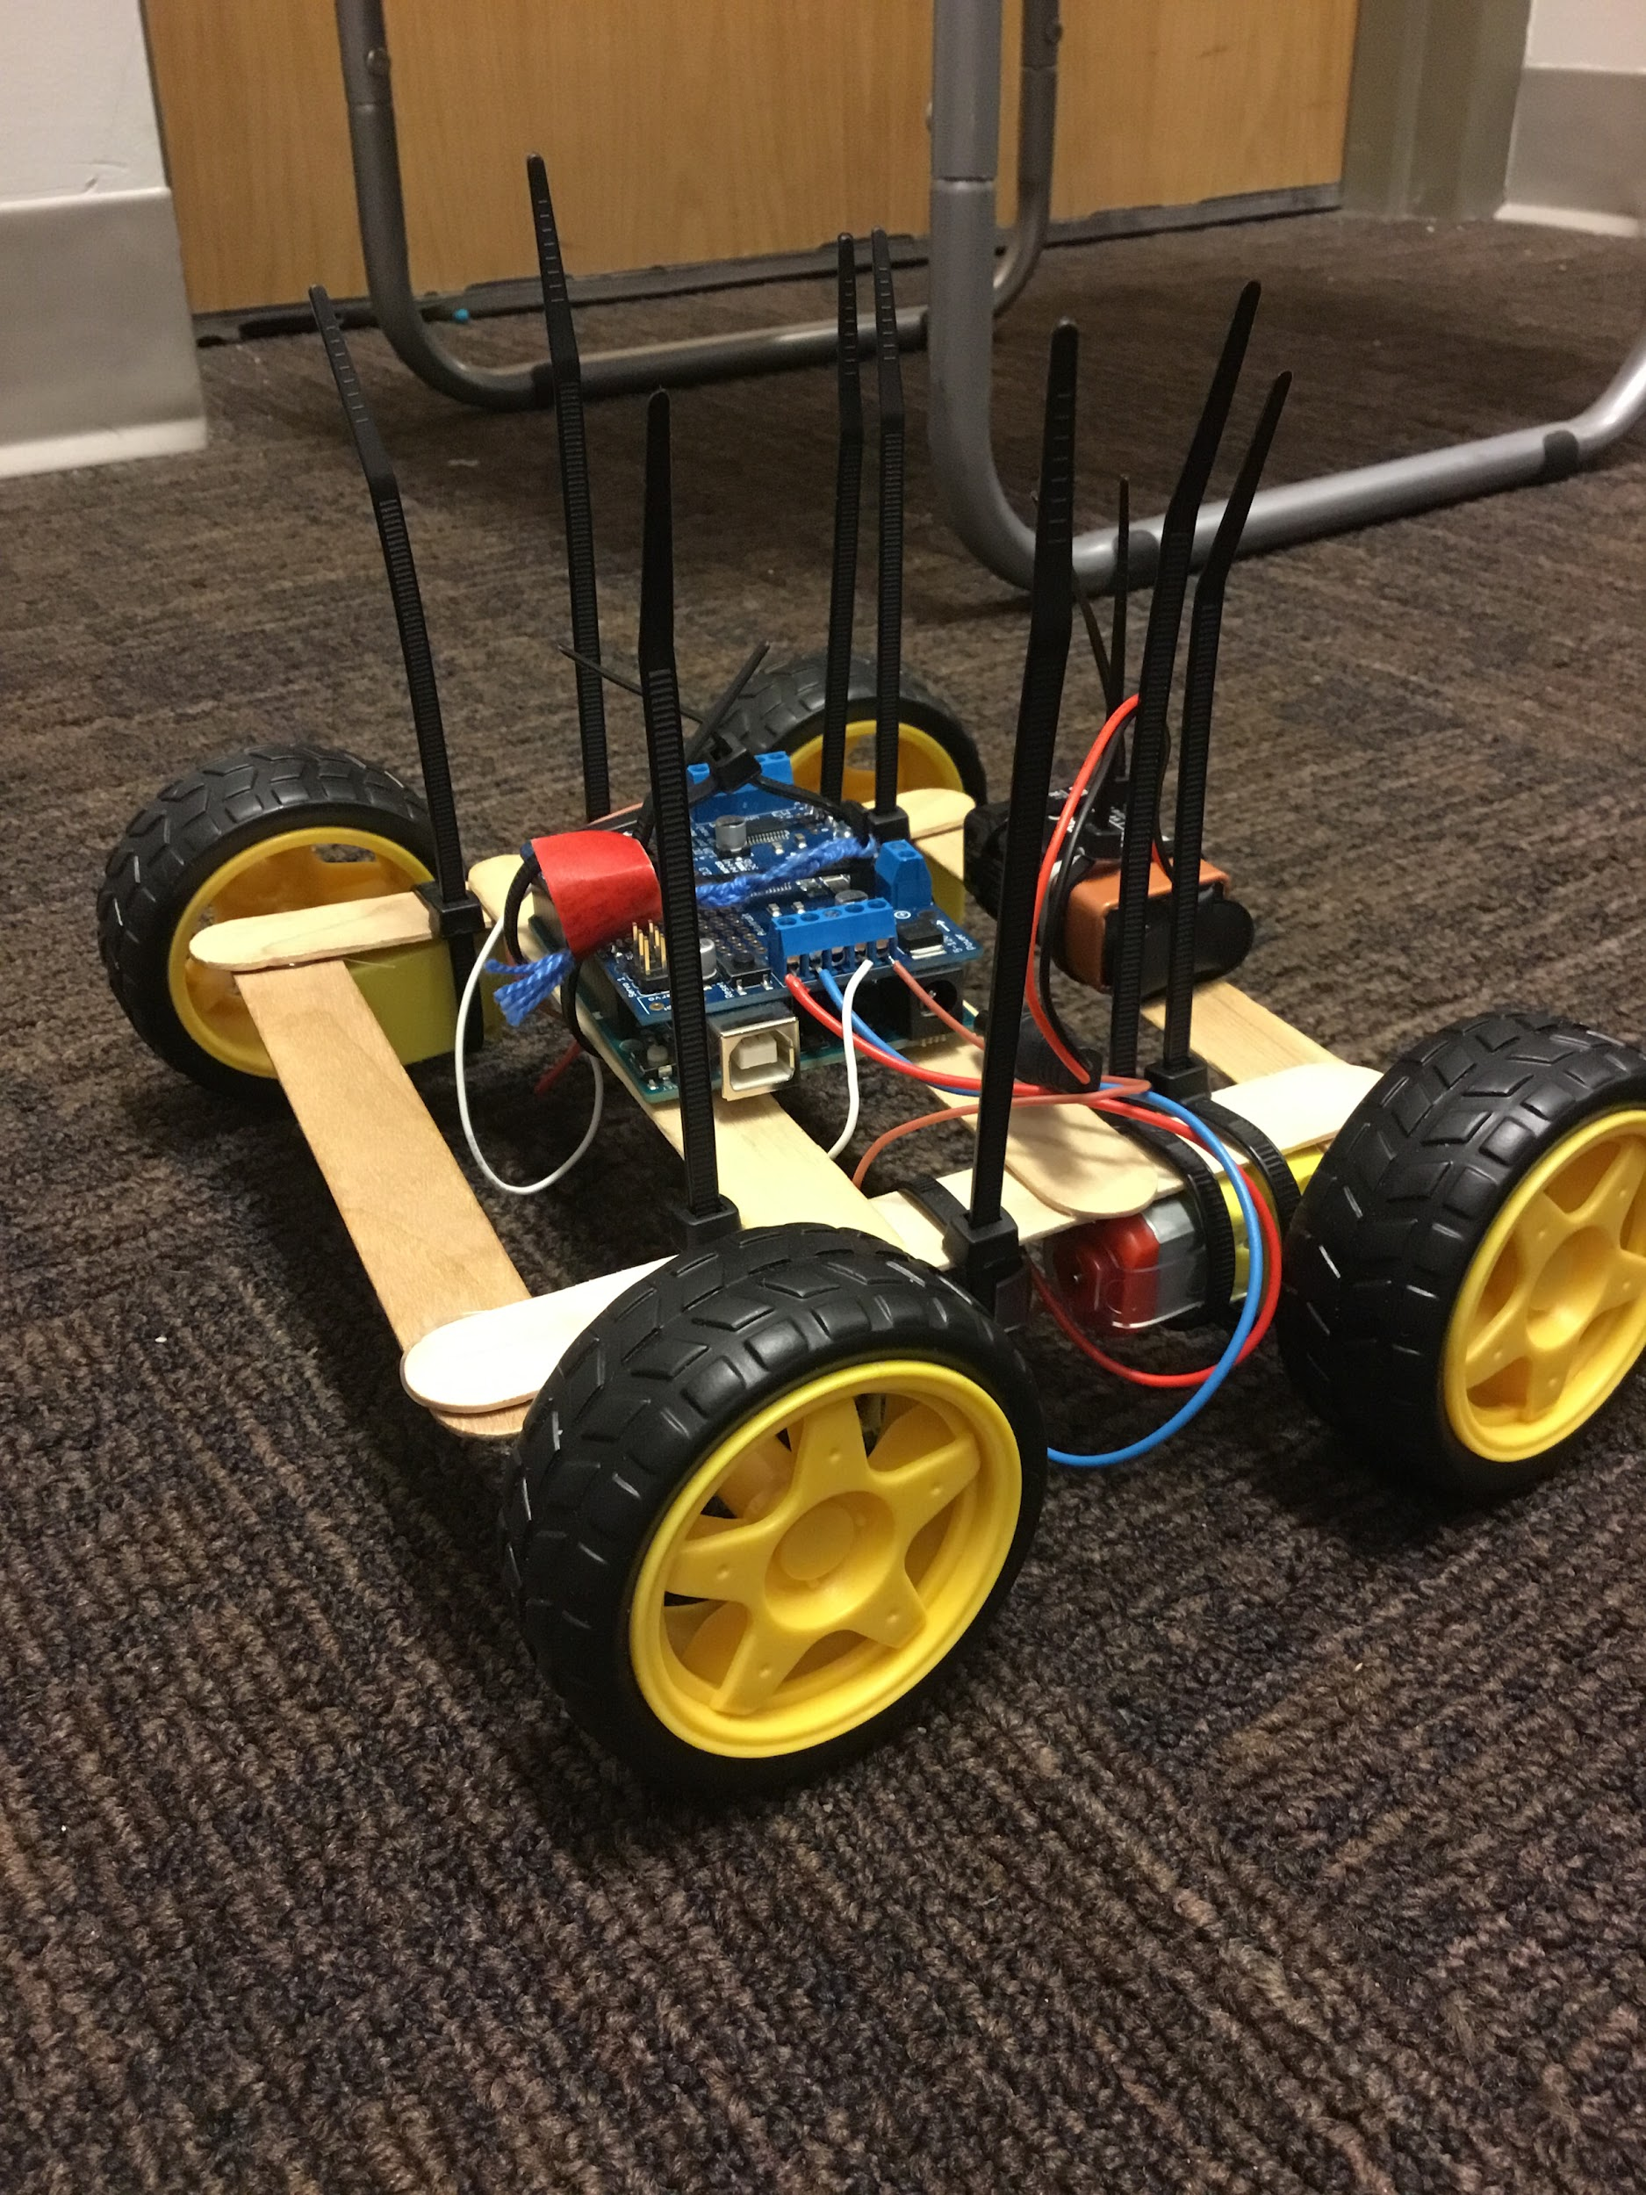
Project History
Started last year
Worked on 2 hr 2 days per week
Final robot 2nd working robot 3 robot attempt
1st fried motors and nearly caught fire
2nd Built robot that drove in a few months
Rest of year working on making this robot with parts from second robot
Had all the materials code and wiring but wires to short and frame not assembled.
Need to modify design to collect data

Slide 4
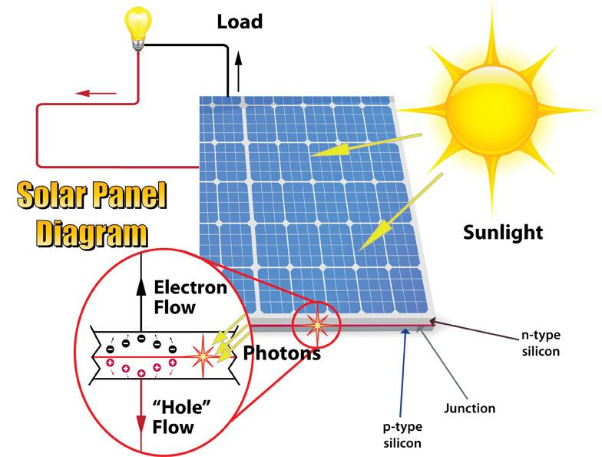
Solar Power:
Solar panels called photovoltaic cells
They rely on the photovoltaic effect
When light particles(Photons) hit solar cell, electrons are knocked loose
If in a circuit electrons travel out negative end through circuit
Electrons returning enter the positive end and fill the holes left by electrons leaving

Slide 5
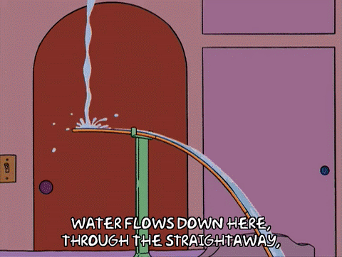
Electricity
Water flow metaphor
Charge:(droplets of water)
Voltage: potential to do work (a bucket of water at a certain height)
Curent: the flow of charge(water moving in a pipe)
Resistance: restrictions on water flow (narrow section of pipe has more resistance/=resistor)

Slide 6
Experimental design

Slide 7
Building a sun seeking solar powered robot to eliminate the need for charging
Qualitative testing:
Problem: lack of power infrastructure in remote locations
Solution: Building a sun seeking solar powered robot that charges itself
Hypothesis: My Robot will work but not be very efficient

Slide 8
How far is too far to travel for optimal sunlight
Quantitative testing:
Question: How far is too far to travel for optimal sunlight?
Independent variable: Distance to optimal sunlight
Dependent variable: How long it takes to recharge the battery if it started at half charge
Control variables: intensity of sunlight, the conditions traveled, battery charging time, solar panel used.
Hypothesis: around 20-30 feet
Second hypothesis: Way more than I originally thought(redesigned test)

Slide 9
What was done before this year
researched, purchased and attached motors capable of supporting the expected weight of the robot.
Built a related robot
programed and tested code for movement,
Brokedown related robot(motors and arduino from original)
I designed and built the base, and protoboard,
Researched, purchased, and tested light detecting sensors
Obtained solar panel
Programed sunseeking code
Got components
ect...

Slide 10
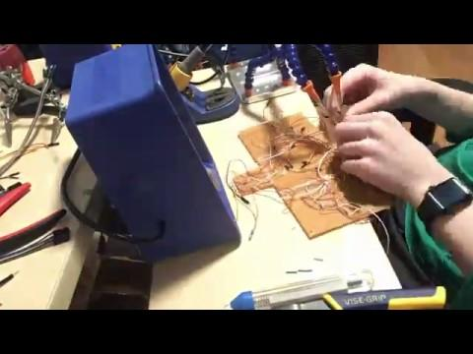
Creating the Robot
A.K.A all my free time for the last 3 weeks
Made the body of the robot from laser cut acrylic sheets, styrofoam and a chopstick
Extended the wires on the protoboard, motors and sensors (see time lapse video)
Placed electronic components on base
Attached sensors and solar panel to the body of the robot
Connected all electronic parts
Made sure all wheels were turning in the right direction and re-calibrated sensors in the code.
Tested for faulty wiring
Fixed and rearranged wiring to accommodate live data displays
Covered all internal exposed wires to prevent short-circuiting
Created mechanism for turning the robot on and off without disassembling it.
Debugged the robot, and discovered the live data displays are for a much larger scale robot
Fixed minor flaws in the code and wrote code needed for testing

Slide 11
Testing the Robot
A.K.A annexing my sisters room for a day
Qualitative testing:
Robot moving
Sensors working
Finding light
Quantitative testing:
Tested how fast the robot moved when executing code approximate to that of finding the sunlight
Measured how much power the robot consumed when moving
Measured how much power the solar panel generated under different lighting conditions.(direct, and half)

Slide 12
Data

Slide 13
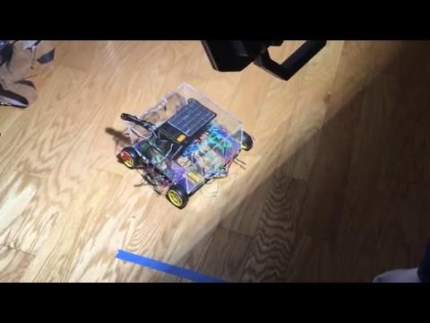
Qualitative
Video

Slide 14
Quantitative
Time Trial
Time(Seconds) | 43.32
Distance(Feet) | 10
Solar trial | Direct light | Half light
Current(Amps) | 0.047 | 0.013
Voltage(Volts) | 6.2 | 3.7
Power(Watts) | 0.2914 | 0.0481
Power Trial
Voltage(Volts) | 8.16
Current(Amps) | 0.262
Power(Watts) | 2.13792
Time trial video

Slide 15
Analysis/Conclusion

Slide 16
Math
BC or Battery capacity(printed on battery): 1.575Wh
Hours to charge full battery(BC/Watts from solar panel):
Distance in feet:X
S or Speed in ft per hour(distance/time*3600):10/43.32*3600=831.0249307
TT or Time to travel in hours: X/S
EUT: Energy used to travel: TT*power used
TTRE or Time to replace energy used to travel: EUT/power produced in direct light
time to charge half battery in half light: Time to charge battery in half light/2=16.37214137
Time to charge half battery and replace energy used moving in full light: Time to charge battery in full light/2+TTRE+TT
Direct light | 5.404941661
Half light | 32.74428274

Slide 17
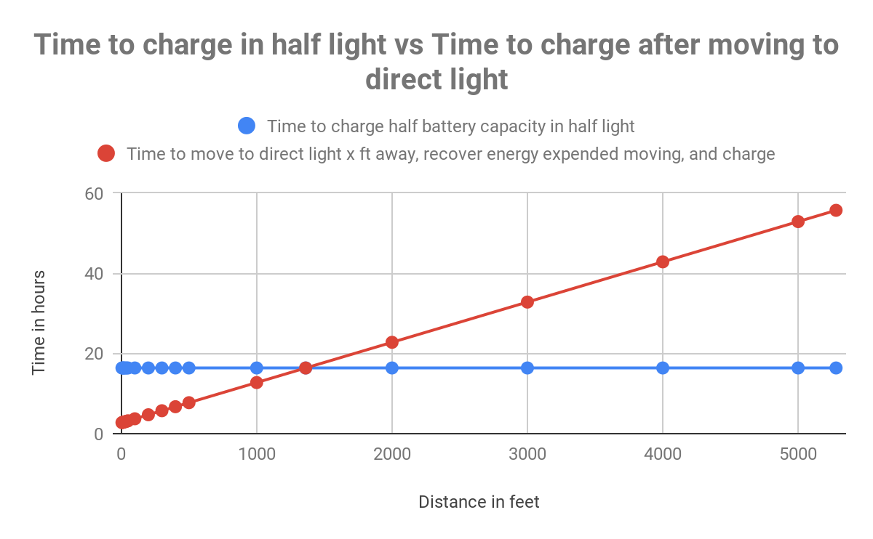
Around (1362,16.3)

Slide 18
Conclusion
Did I achieve my goal:
Qualitative:
yes
I built a sun seeking solar powered robot
Shown in qualitative data
Quantitative
Yes
More than 1362 ft is too far to travel
See Graph

Slide 19
Conclusion 2
Qualitative hypothesis: work but not efficient
Result: Work but not efficient(battery charge time, speed, video)
Quantitative Hypothesis:20-30ft
Result:1362ft

Slide 20
Ideas to improve
Elevate solar panel at a 45º angle facing forwards on the robot and adjusting the code so that the robot would turn to face the sun.
Adjust code that stops the robot when going back and forth to stop in next bright area not after # of back and forths
Finding other live data displays for a smaller scale circuit

Slide 21
Uniqueness

Slide 22
People built robots before
Some with solar panels
My robot designed for the purpose of finding sunlight

Slide 23
Bibliography
Reaserch:
Knier, Gil. “How do Photovoltaics Work.” SHARE THE SCIENCE, NASA SCIENCE, Aug 6, 2008, https://science.nasa.gov/science-news/science-at-nasa/2002/solarcells. Accessed 2 Dec. 2018.
“DC Circuit Water Analogy.” Water Circuit Analogy to Electric Circuit, hyperphysics.phy-astr.gsu.edu/hbase/electric/watcir.html.
IMages:
https://techmythtruths.files.wordpress.com/2016/12/solar-panel-diagram-large1.jpg

